Slide 1

Web Scraping Data from Cars24.com Presented by Team C Members:
Rohit Sharma
Aishwarya Vijay Ighepatil
Jigyasa Karakoti
Sanath Kumar P S
Vishal Terence Vaz
Gopinath .R
Sandeep Sharma
Ravi Chandra
Varshitha. N
Rahul L Jain
Shameer sutar
Ankur
Ramanathan
Girijanath P
Muskan Tripathi
Haridhar K B
Kavidurga Vaiyapuri
R.YASWITHA
Mandadi Harshitha Reddy
Srinidhi Madanagopal

Slide 2
Index
Objective of the mini project
Requirements
Flowchart
Methodology(with code snippets)
Data Visualization using Python Libraries
Data Visualization(Using PowerBI dashboard)
Conclusions Drawn

Slide 3
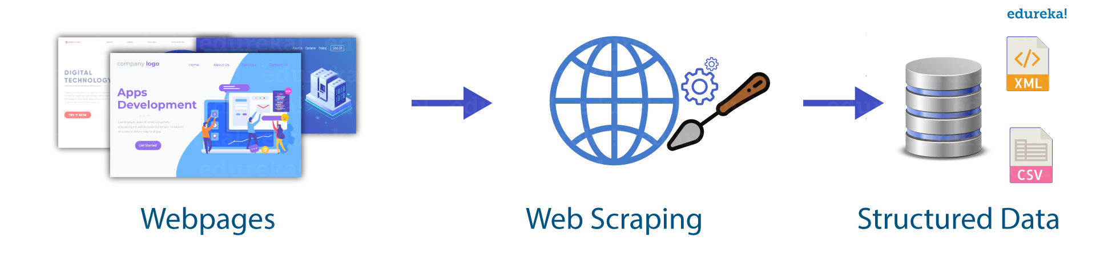
Objective of the Mini Project
The objective of this mini-project is to develop skills in web scraping by extracting and analyzing car details from Cars24.com. All team members gathered data specific to the Mumbai location, covering key information such as kilometers driven, year of manufacture, fuel type, transmission, and price. By the end of this project, members will have hands-on experience in web scraping, data cleaning, and presenting structured data for analysis.

Slide 4
Requirements and Installations
Python: Ensure you have Python installed on your system.
IDE: Preferably Google Colab, Jupyter Notebook or Visual Studio Code
Libraries: The following Python libraries are required:
Pandas
Selenium
bs4 (BeautifulSoup)
webdriver_manager
re (Regular Expressions, part of the standard library)
Matplotlib
Seaborn
warnings (part of the standard library)

Slide 5
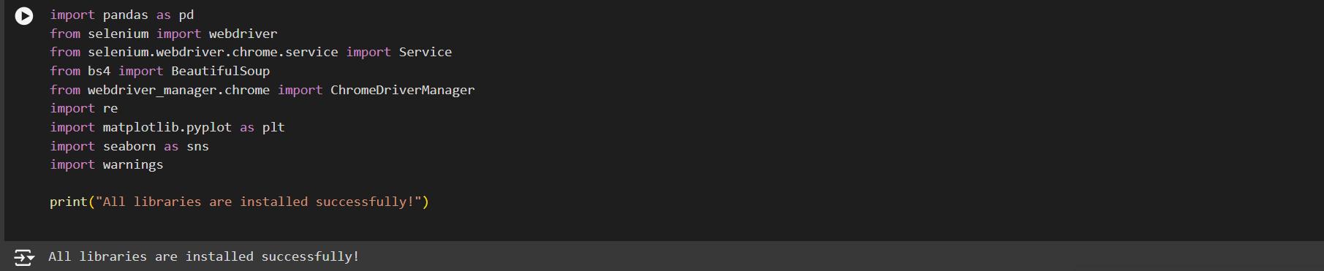

Slide 6
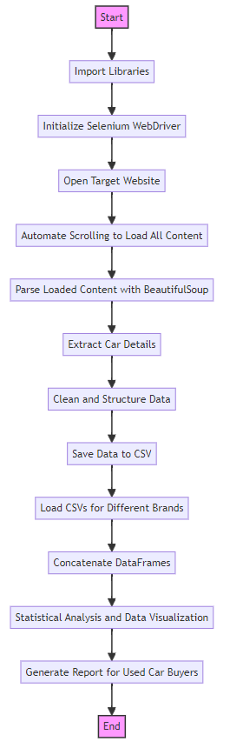
Working Flowchart

Slide 7
Methodology:
Assigned Brands: Maruti, Tata, Hyundai, Toyota
Assigned Location: Mumbai
1. Research and Planning:
Understand the structure of https://www.cars24.com/
Identify the HTML elements containing the required information.
2. Data Extraction:
Write a script to scrape the necessary details (kilometers driven, year of manufacture, fuel type, transmission, and price) for the assigned brand.

Slide 8
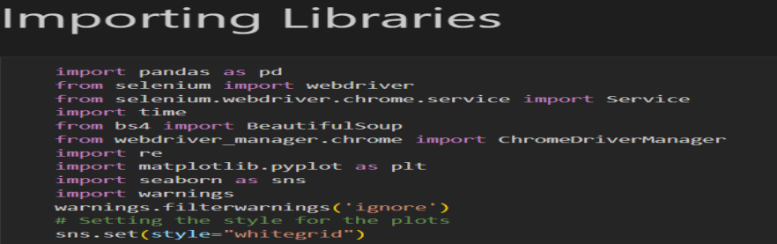
3. Initialize Selenium WebDriver:
Selenium WebDriver is set up and configured to use the Chrome browser.
This allows for automated interaction with the website.

Slide 9
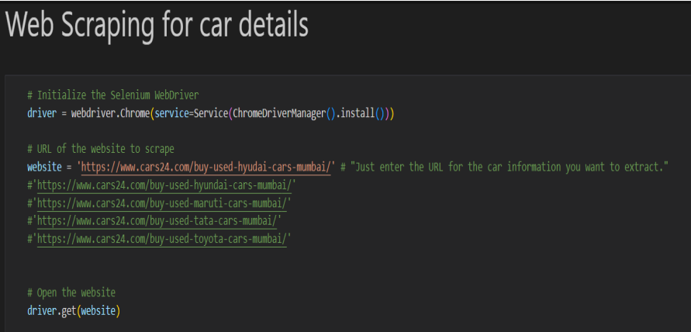
4. Open the Target Website:
The WebDriver navigates to the specified URL of the car listing page.

Slide 10
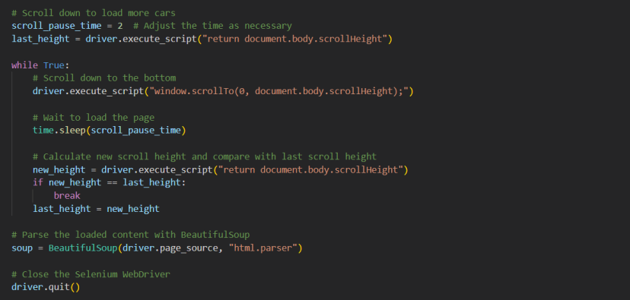
5. Automating Scrolling:
Selenium allows the script to simulate user actions such as scrolling down the page. This is essential for loading more car listings that are not visible initially.
6. Automate Scrolling to Load All Content:
The script repeatedly scrolls down the page to trigger dynamic loading of additional car listings. It waits for a short period after each scroll to ensure new content is loaded.
7. Dynamic Content Loading:
Many modern websites, including car listing sites, use JavaScript to load content dynamically. This means that not all the data is present in the initial HTML source but is loaded as the user scrolls or interacts with the page.
8. Parse Loaded Content:
After all content is loaded, the page source is parsed using BeautifulSoup to extract the relevant HTML elements

Slide 11
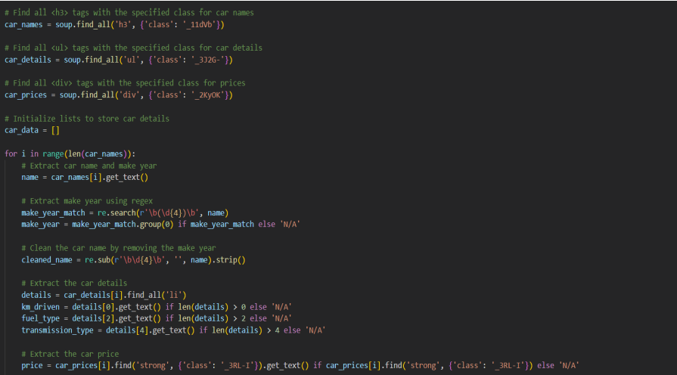
9. Extract Car Details:
The script finds and extracts car names, details, and prices from the HTML elements. For each car, it extracts the car name and manufacturing year, kilometers driven, fuel type, and transmission type from the details list and price from the price tag.

Slide 12
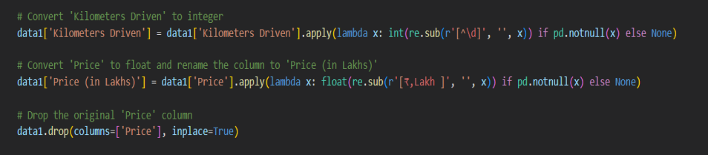

9. Data Cleaning:
Ensure the scraped data is clean and organized for analysis. The extracted data is cleaned (e.g., removing the make year from car names) and structured into a list.
10. Saving Data into file:
The structured data is converted into a pandas DataFrame and saved to a CSV file.

Slide 13
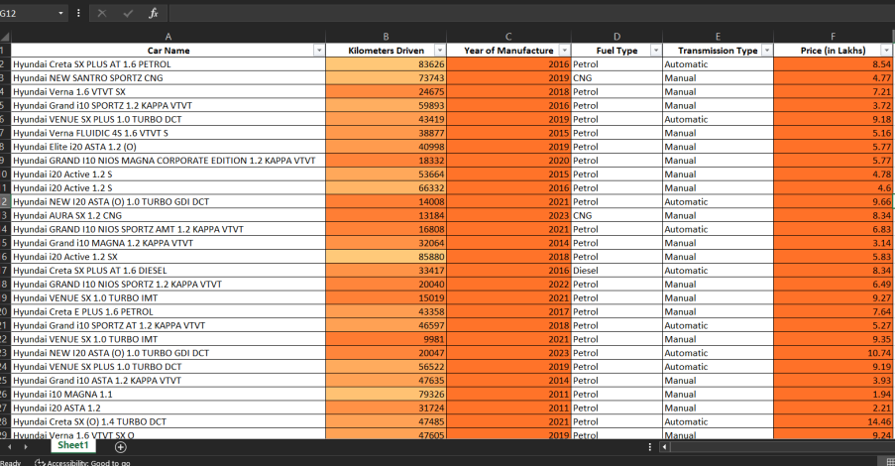

Slide 14
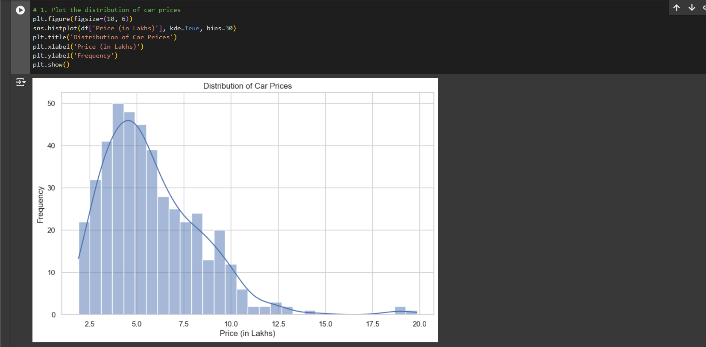
Data Visualization using Python
Histogram:

Slide 15
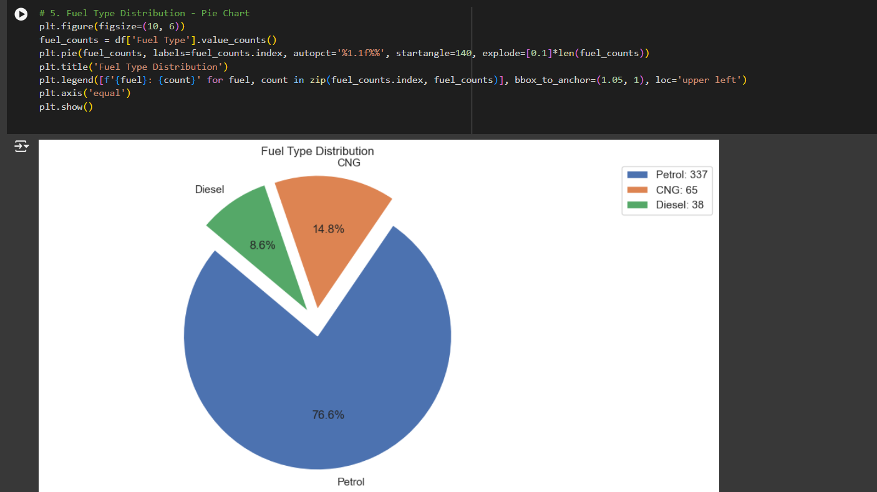
Pie-Chart

Slide 16
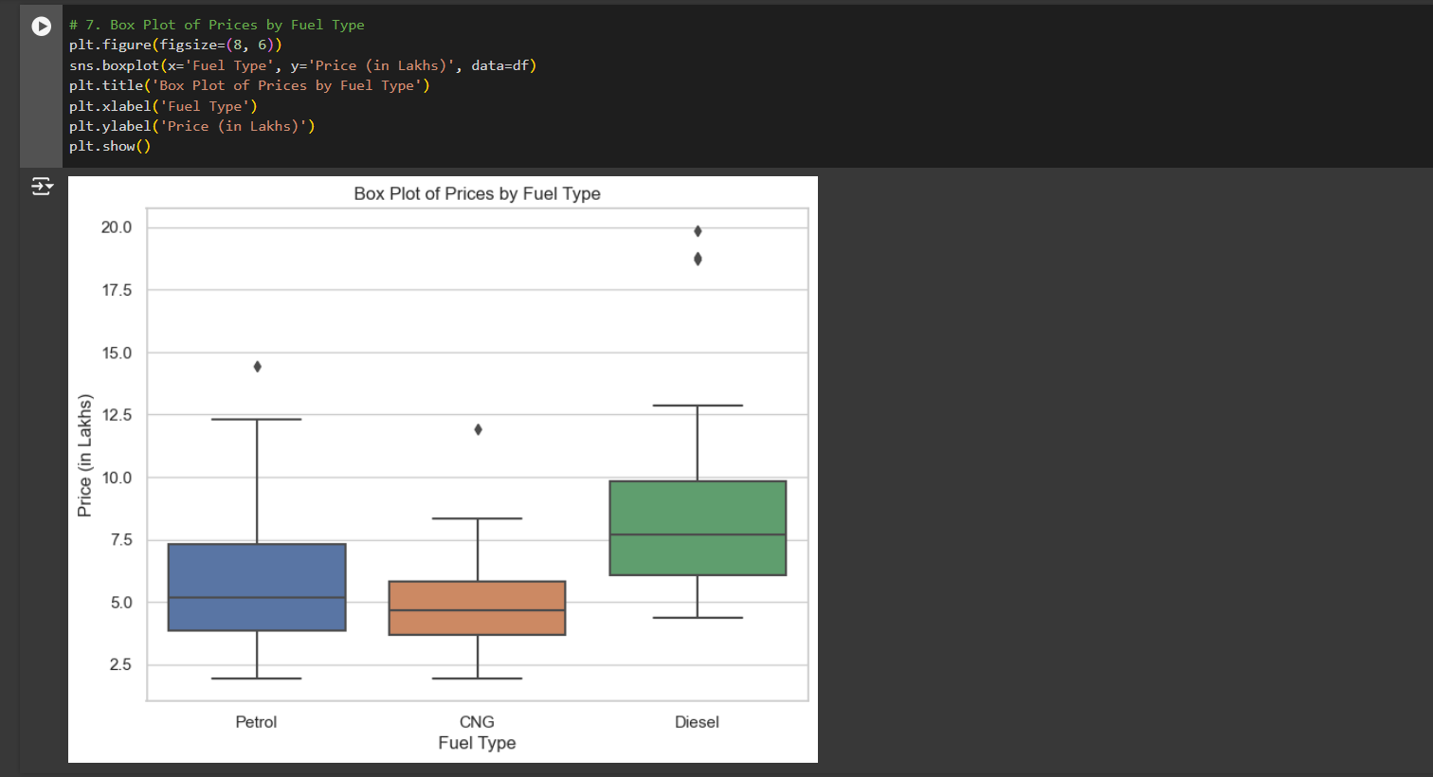
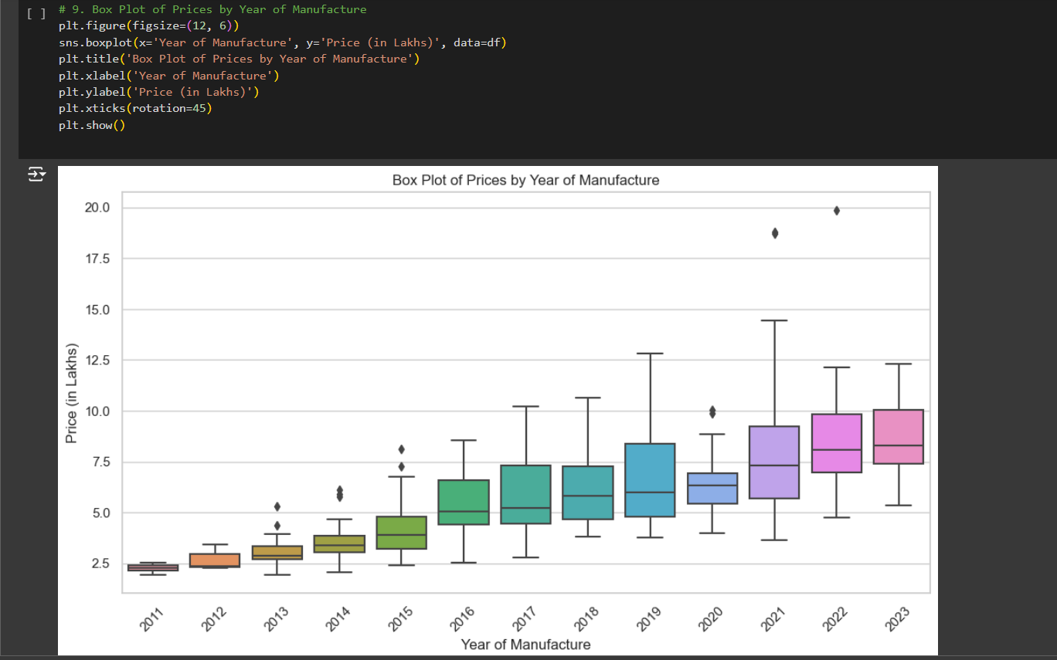
Box-Plot

Slide 17
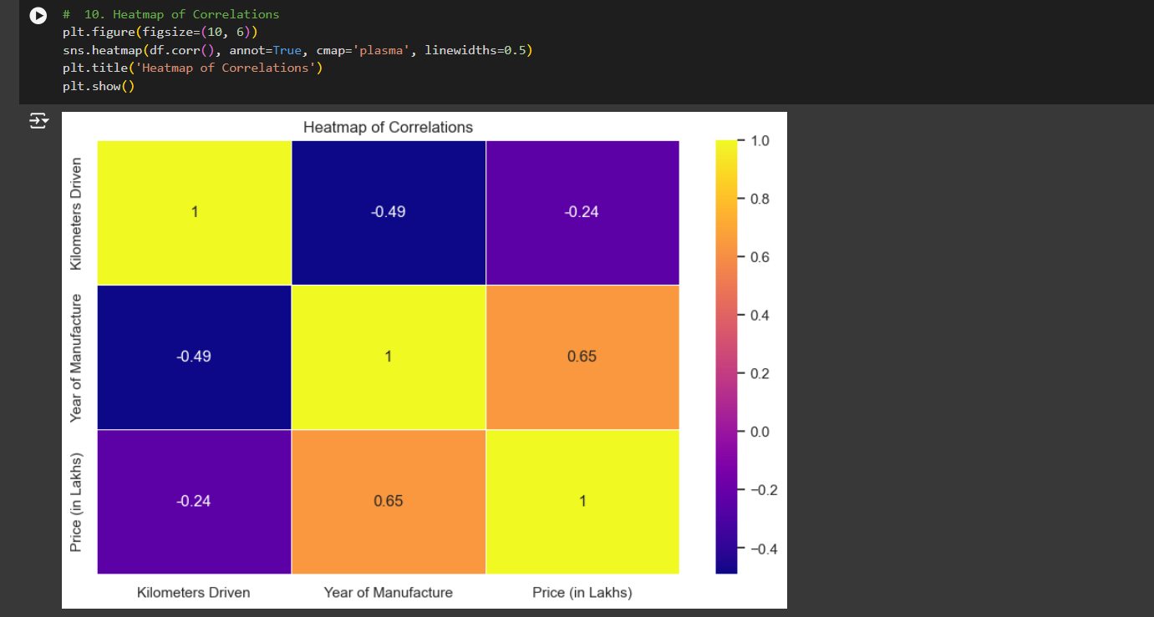
HeatMap:

Slide 18
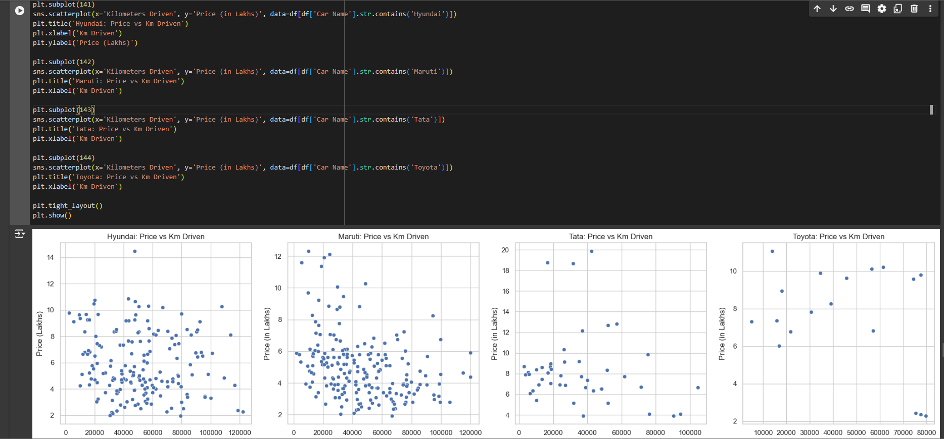
ScatterPlot:

Slide 19
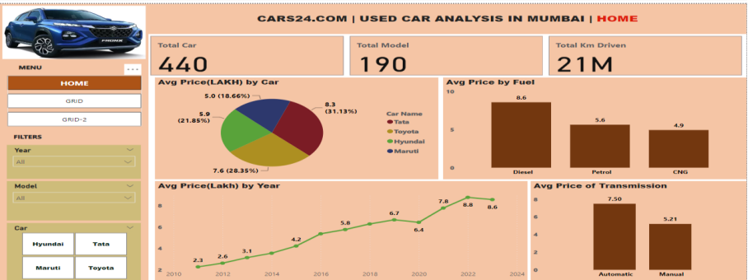
Power BI Dashboards

Slide 20
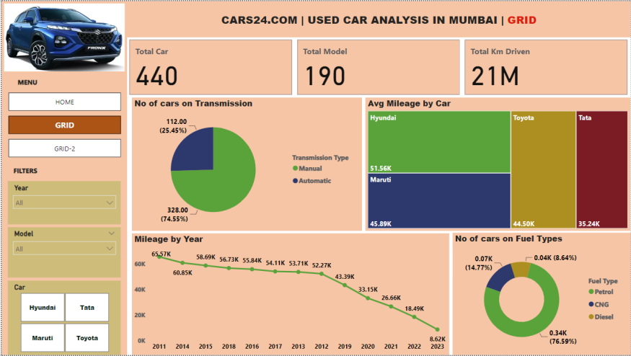

Slide 21
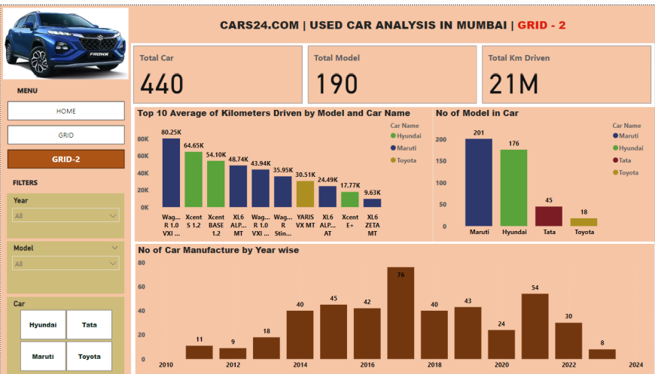

Slide 22
Conclusions Drawn from the data extracted
1. Price Considerations:
Most used cars in the market are priced between 2-8 lakhs, with the most common range being 4-6 lakhs.
Newer cars (2019-2022 models) are more abundant and generally pricier.
Diesel cars tend to be more expensive, followed by petrol, with CNG being the most affordable option.
Automatic transmission vehicles command a premium over manual ones.

Slide 23
2. Mileage Insights:
The majority of used cars have been driven between 20,000 to 80,000 kilometers.
Higher mileage generally correlates with lower prices, but other factors like brand and condition also play a role.
3. Fuel Type Availability:
Petrol cars dominate the market (about 80%), offering the widest choice.
Diesel cars make up about 15% of the market and tend to be pricier.
CNG cars are less common but offer an economical option for budget-conscious buyers.

Slide 24
4. Transmission Options:
Manual transmission cars are more widely available (75% of the market) and generally cheaper.
Automatic cars, while pricier, are increasing in availability, especially in newer models.
5. Brand-Specific Insights:
Maruti: Offers the most affordable options with a focus on manual transmission and petrol engines.
Tata: Shows rapid price increases in recent models. Offers more diesel options compared to other brands.
Hyundai: Provides a balanced mix of fuel types and steady price progression over the years.
Toyota: Maintains higher prices even for older models. Offers mostly petrol cars with a good mix of automatic options.

Slide 25
Challenges and Overcoming Them
Dynamic Data Loading:
BeautifulSoup alone was inadequate due to dynamic content loading on the website.
This challenge was overcome by using Selenium to automate browser actions and fully load the data before extraction.
Data Cleaning:
The extracted data required significant cleaning, especially in standardizing car names and separating the manufacture year from the car name for better readability and conversion to correct data types.

Slide 26


